Slide 1
Plant Disease Detection System
A
Project Presentation
Submitted In Partial Fulfillment Of The Requirements
For The Award Of The
Minor Project
Under The Guidance Of
Prof. Pratap Sharma

Slide 2

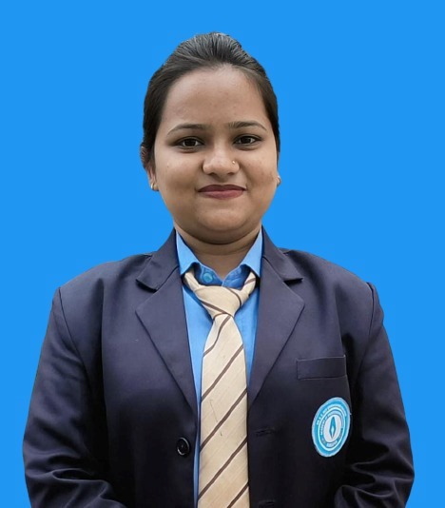

Submitted By
Kunal Gautam Sweta Singh Sayan Golder
32301222091 32301222033 32301222031

Slide 3
CONTENT
INTRODUCTION
BACKGROUND
METHODOLOGY
TECHNICAL OVERVIEW
FINDINGS
CONCLUSION

Slide 4
INTRODUCTION

Slide 5
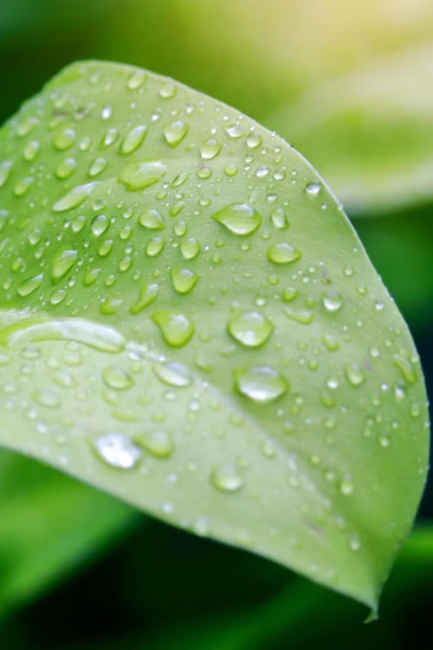
What...??
We created a Plant Disease Detection System that combines artificial intelligence and software technology to develop a fully functional solution for detecting plant diseases. This project integrates a web application and WhatsApp communication powered by AI-based models for accurate disease diagnosis.
The project utilizes Flask and Fast-API for backend functionality, enabling the prediction of plant disease using pre-trained machine learning models. It also incorporates Twilio API for real-time WhatsApp interactions, allowing users to upload plant leaf images and receive diagnosis results directly through messaging The system processes the input image, analyzes it using Convolutional Neural Networks (CNNs), and returns the disease name with confidence scores, providing actionable insights for farmers and agricultural professionals.

Slide 6
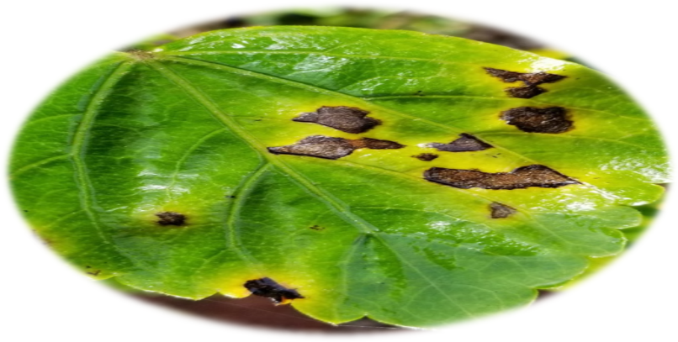
Why...??
Crop Scarcity Detection

Slide 7
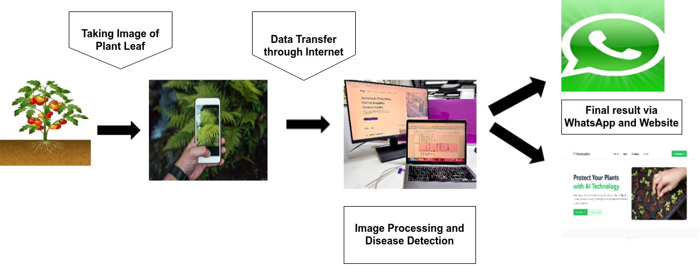
How...??

Slide 8
OBJECTIVE
1. AI-Driven Disease Diagnosis: Utilize Convolutional Neural Networks (CNNs) to analyze plant leaf images and predict diseases with high accuracy and confidence scores.
2. Real-Time WhatsApp Integration: Enable users to upload leaf images and receive instant disease diagnoses via Twilio's WhatsApp API.
3. Efficient Backend Infrastructure: Develop a reliable backend using Flask and Fast API for streamlined image processing, machine learning model inference, and rapid result delivery.

Slide 9
MOTIVATION
Early detection of plant diseases can help farmers take timely action, reducing crop loss and improving overall agricultural yield.
Many farmers lack access to expert advice or tools for identifying plant diseases. This system provides an accessible, automated, and user-friendly solution.
Combining artificial intelligence with modern communication technologies, like WhatsApp, demonstrates how technology can solve real-world challenges in agriculture.
Creating an affordable, scalable system for disease detection that can reach a wider audience, especially in rural and underserved areas.
Accurate diagnosis helps reduce unnecessary pesticide use by identifying specific diseases, leading to healthier crops and eco-friendly farming practices.

Slide 10
What is Plant Disease Detection?
Detects plant diseases by analysing symptoms from images of leaves .
Utilizes trained models like CNNs for accurate and automated disease classification.
Helps identify diseases early, preventing crop loss and reducing damage.
Plant Disease Detection systems identify infections at an early stage, enabling timely intervention to reduce plant damage and improve yield

Slide 11
What we did ...
METHODOLOGY

Slide 12
DATA COLLECTION AND PRE-PROCESSING
Data collection
Data Pre-Processing
Resizing
Normalization
Data Augmentation

Slide 13
Why CNN...??
Performance: CNNs offer exceptional performance in image classification and pattern recognition tasks, making them ideal for plant disease detection from leaf images.
Accuracy: CNNs are designed to automatically learn features from raw images, providing high accuracy in detecting subtle symptoms of plant diseases that might be missed by traditional methods.
Efficiency: With their ability to process large amounts of image data, CNNs can classify plant diseases in real-time, ensuring quick and reliable results.
Proven Track Record :CNNs have been widely adopted in the field of computer vision due to their effectiveness, and they have shown significant success in tasks such as object detection and image classification.
Community support: The widespread use of CNNs means there's a vast pool of pre-trained models, research papers, and community resources available to improve the model’s performance in plant disease detection..​

Slide 14
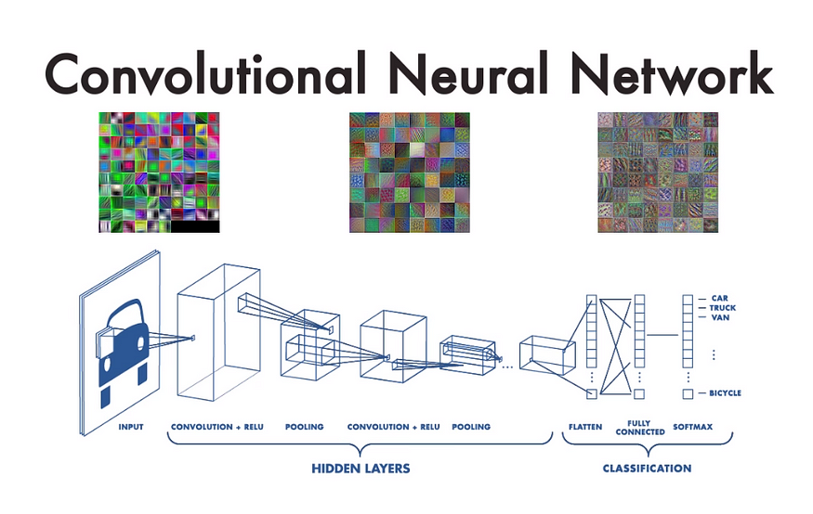
ALGORITHM (CNN)
Different Types of layers in CNN.
Input Layer
Convolution Layer
Activation Function Layer
Pooling Layer
Fully Connected Layer

Slide 15
EXPERIMENTAL SETUP & TEST DATA
Dataset Collection and Preprocessing
Building the CNN Model and Training
Finding Dataset
Model Evaluation
API Development
Performance Evaluation
Testing and Debugging
Iterative Improvement

Slide 16
How we did ...
TECHNICAL
OVERVIEW

Slide 17
REQUIREMENTS
GOOGLE COLAB
TWILIO
TEACHABLE MACHINE
FAST API

Slide 18
GOOGLE COLAB
Colabotary or "Colab” for short, is a product from Google Research.
Colab allows anybody to write and execute arbitrary python code through the browser, and is especially well suited to machine learning, data analysis and education.
Colab is a hosted Jupiter notebook service that requires no setup to use, while providing access free of charge to computing resources including GPUs.

Slide 19
TWILIO
Twilio is a cloud communications platform that enables developers to build applications for messaging, voice, and video communication.
In the context of our project, Twilio allows seamless integration of WhatsApp to send and receive messages, enabling users to upload images and receive real-time plant disease detection results directly through WhatsApp.
It simplifies communication by providing APIs that handle the complexities of messaging, ensuring a smooth and efficient user experience.

Slide 20
FAST API
Fast API is a modern, fast (high-performance) web framework for building APIs with Python 3.7+ based on standard Python type hints.
In the context of our project, Fast API is used to create and manage the backend API that handles image uploads and disease predictions. It allows for fast, efficient processing of incoming plant leaf images, running them through the trained machine learning model, to delivered accurate disease and confidence score in real-time.
Fast API’s automatic validation, serialization , and fast execution and make it an ideal choice for building high-performance web application.

Slide 21
TEACHABLE MACHINE
Teachable Machine is a web-based tool developed by Google that allows users to create and train machine learning models without requiring extensive coding knowledge.
Easy training
Export models
Applications
Educational tools
The tool provides a user-friendly interface where users can easily upload their own images, sounds, or poses to train the model.

Slide 22
FINDINGS...

Slide 23
Model Integration:
Model Integration refers to the process of embedding a trained machine learning model into a software application or system for seamless functionality.
In the context of the Plant Disease Detection System, model integration involves embedding the trained Convolutional Neural Network (CNN) into the backend using Fast API. This API facilitates efficient communication between the machine learning model and the web application or WhatsApp integration, enabling real-time disease detection for end-users.
The integration of the model with Fast API ensures smooth processing of plant leaf images, provides accurate predictions with confidence scores, and supports seamless interactions across web and messaging platforms. This approach enhances the system's reliability and scalability, delivering an optimized user experience.

Slide 24
Model integration involves several steps, including:
Loading the model into memory: The trained Convolutional Neural Network (CNN) model is loaded into the application’s memory using Fast API, enabling it to process plant leaf images in real-time.
Providing inputs to the model: Users upload images of plant leaves through the web interface or WhatsApp. These images are pre-processed and passed as inputs to the model for analysis.
Processing the model's output: The model outputs the detected plant disease along with a confidence score. This output is processed and formatted into meaningful feedback, which is then displayed on the web application or sent back to the user via WhatsApp.

Slide 25
Testing:
Sample Input | Expected Output | Obtained Output | Status
Image of a Mosaic Virus | Mosaic virus | Mosaic virus | Success
Image of a Traget Spot | Traget Spot | Traget Spot | Success
Image of a Septoria leaf | Septoria leaf spot | Septoria leaf spot | Success
Image of Leaf Mold | Leaf Mold | Leaf Mold | Success
Image of a healthy leaf | Healthy Leaf | Healthy leaf | Success
Image of a Water Bottle | Wrong Image | Wrong Image | Success

Slide 26
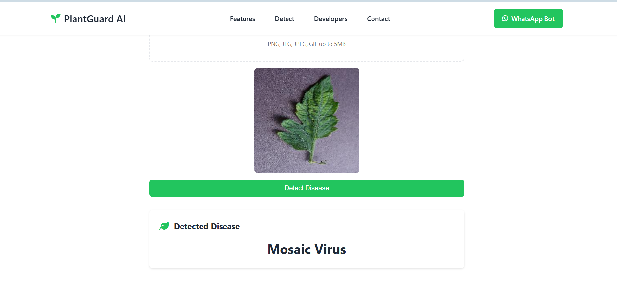
Sample Test Output:

Slide 27
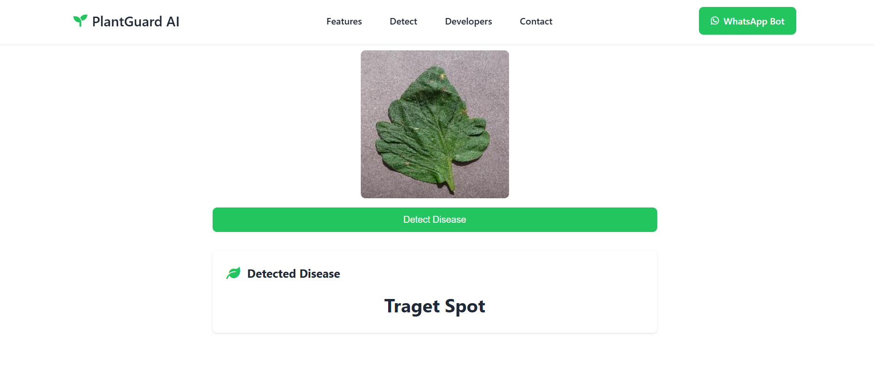
Sample Test Output:

Slide 28
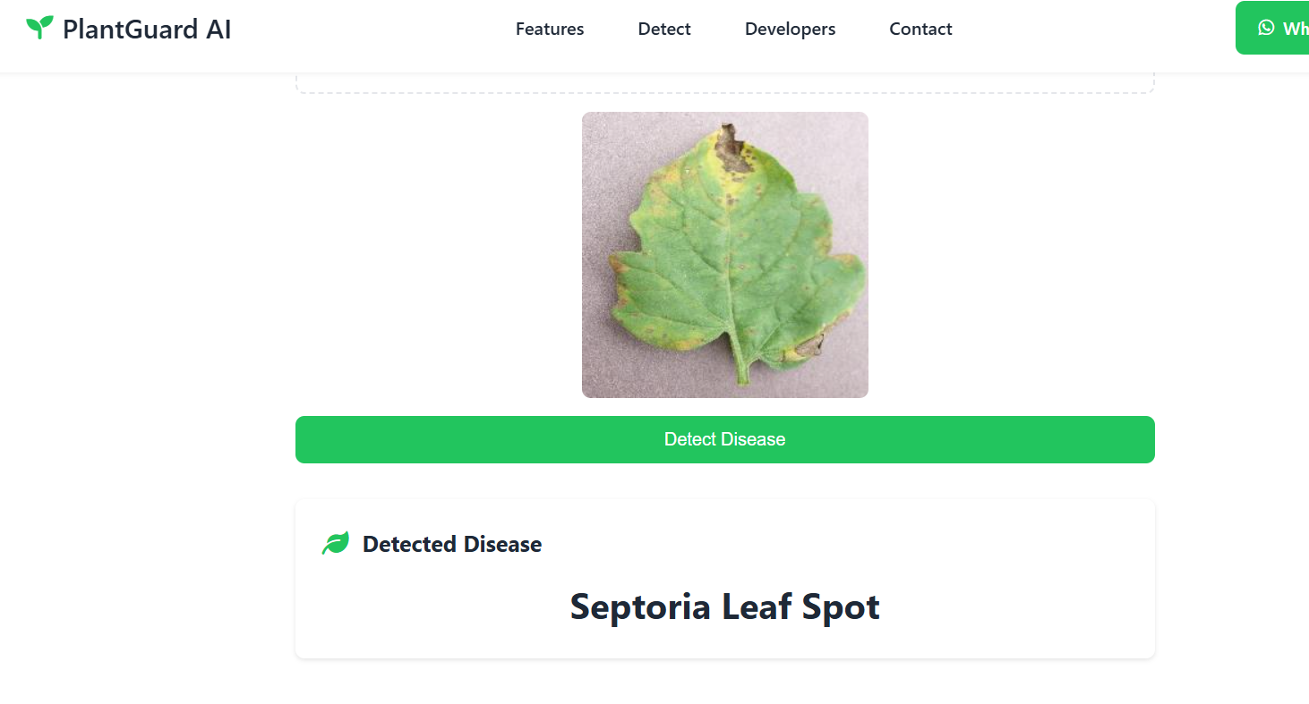
Sample Test Output:

Slide 29
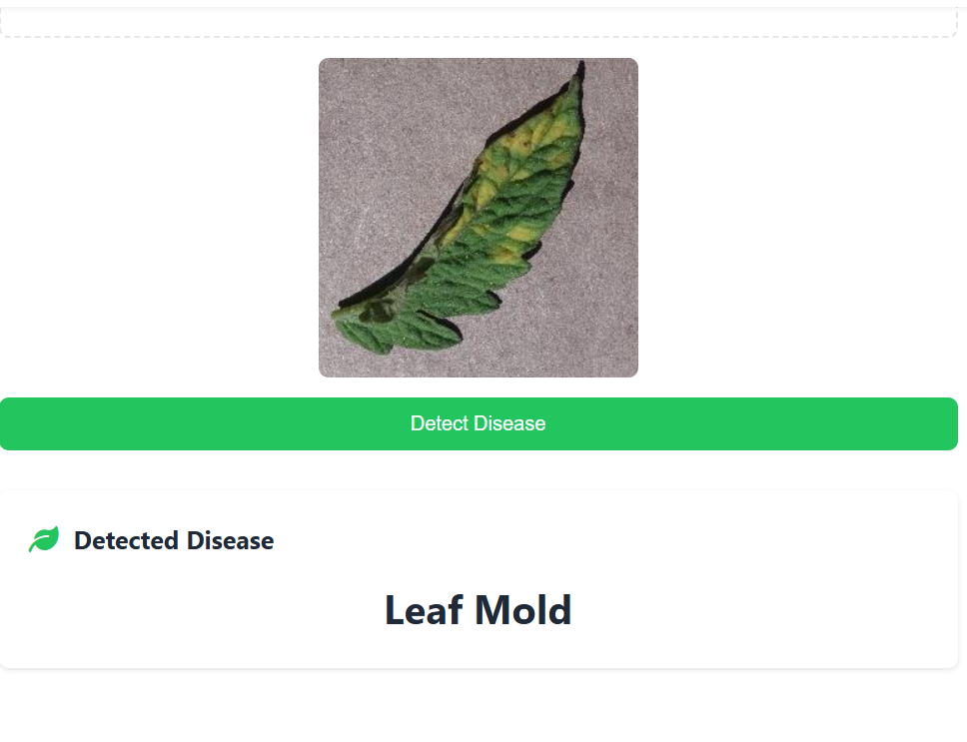
Sample Test Output:

Slide 30
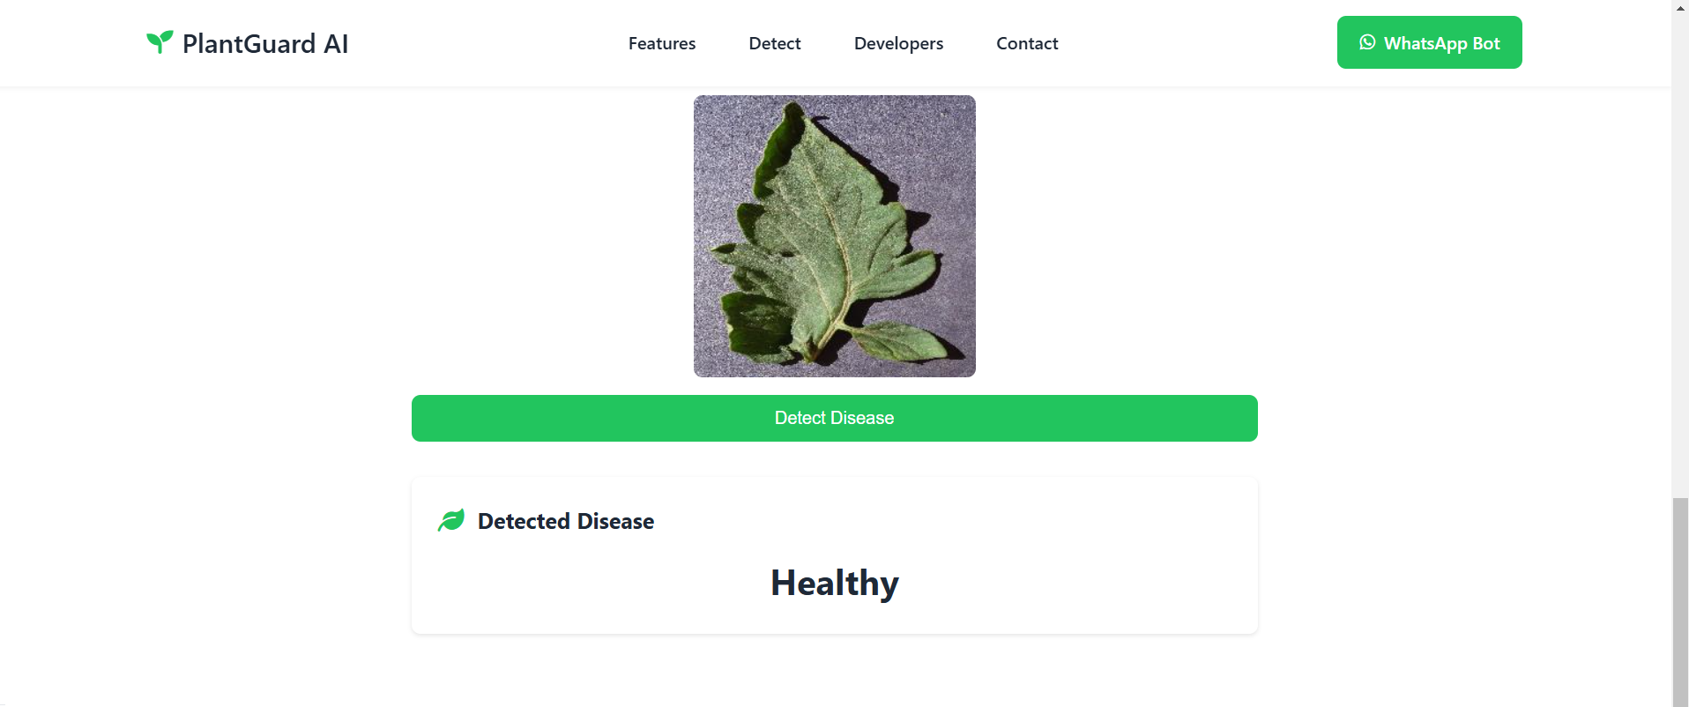
Sample Test Output:

Slide 31
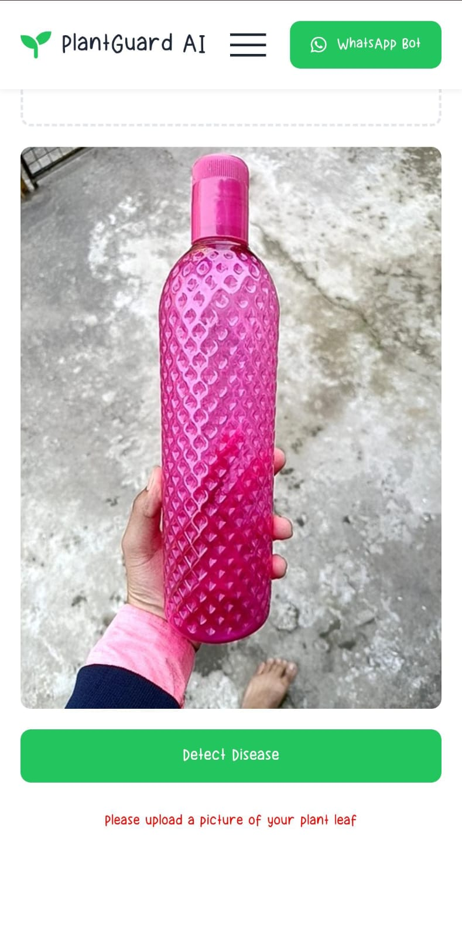
Sample Test Output:

Slide 32
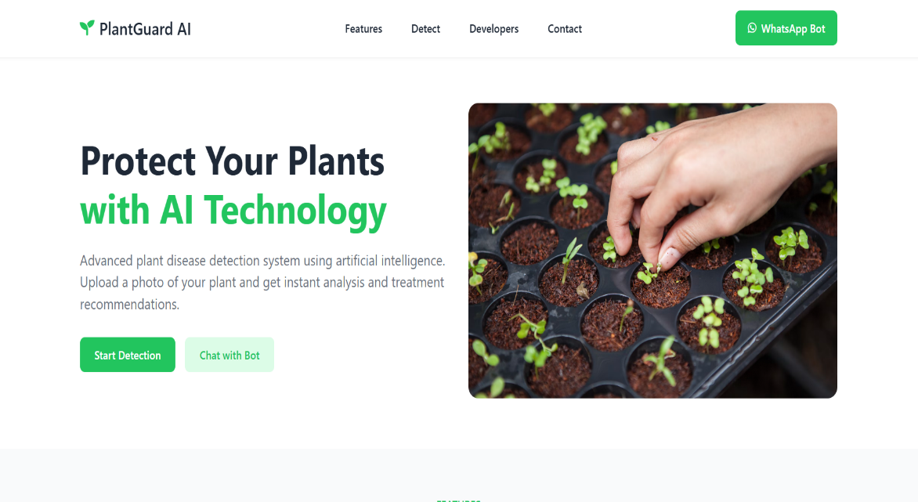
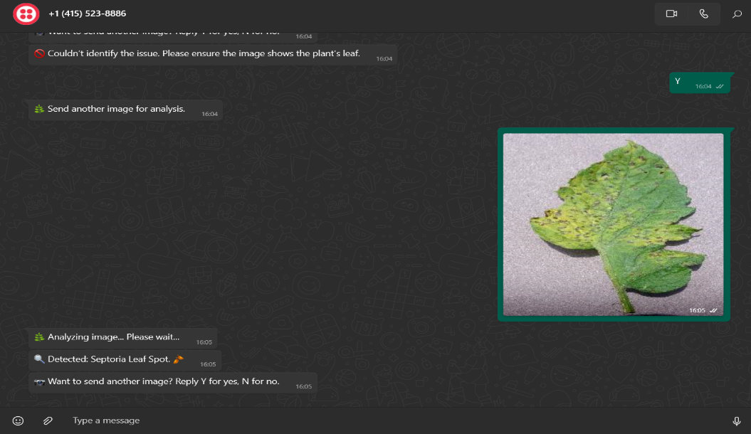
Enhancing the User Experience: Seamless Integration of Website and WhatsApp
Website Access
WhatsApp Convenience
Users can access the web application for detailed information, including plant care guides and treatment options.
WhatsApp provides an accessible and familiar platform for quick access, especially for users who lives in rural area

Slide 33
Optimization
After testing, the model can be optimized to improve its performance.
Optimization involves identifying bottlenecks in the model's performance and applying optimization techniques to address them.
Optimization techniques may include optimizing the code for better performance, reducing the model's size, and adjusting the model's hyperparameters.
Ensure high-quality data with techniques like augmentation to improve generalization.

Slide 34
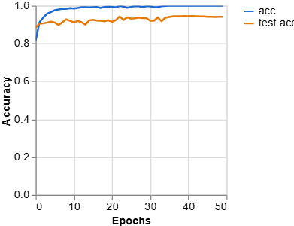
ACCURACY MEASURE PER EPOCHS:

Slide 35
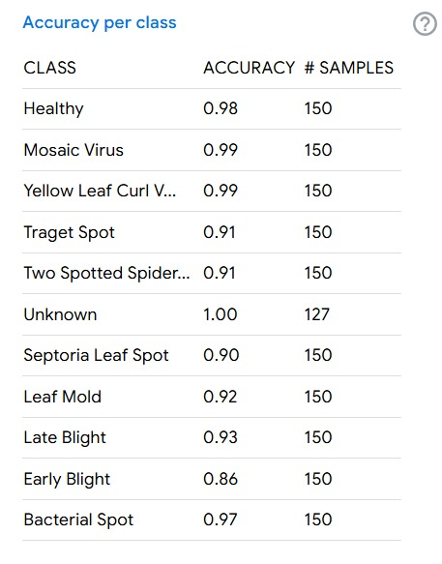
ACCURACY PER CLASS:

Slide 36
Conclusion
Addressed issue: Addressed issue is where the issues faced are discussed.
1. Image distance
2. Single leaf image at a time
3. Limitation of cloud platform
4. Limitation of image and its angle with the trained models
Proposed resolution: The Plant Disease Detection System leverages Convolutional Neural Networks (CNN) and modern technologies to accurately predict plant diseases. By addressing image quality issues and cloud platform limitations, the system provides valuable insights for farmers and agricultural professionals to enhance crop health and sustainability.

Slide 37
Conclusion
Major findings: Major finding of our project is Accuracy .
Limitations: Everything in world has its own limitation, similarly our project also has some limitations like:
1. Have to optimize distance camera angle.
2. Have to adjust background surroundings.
3. Difficult to create a proper trained dataset
4. Cloud platform is always preferable instead of local machines .
5. The system currently identifies diseases but does not provide specific solutions or treatment plans.

Slide 38
THANK YOU

